Slide 1
Networks and Communications
6
Chapter 6

Slide 2




Chapter 6 Overview
Part 1 : Communications
Communication Systems
Connectivity
Channels
Part 2: Network
Terminologies
Types of network
Network strategies
Part 3: Careers in IT
Part 4: Trends in Network

Slide 3
Learning Objectives
Explain connectivity, the wireless revolution, and communication systems.
Describe physical and wireless communications channels.
Differentiate between connection devices and services, including dial-up, DSL, cable, satellite, and cellular.
Describe data transmission factors, including bandwidth and protocols.
Define networks and key network terminology including network interface cards and network operating systems.
Describe different types of networks, including local, home, wireless, personal, metropolitan, and wide area networks.
Describe network architectures, including topologies and strategies.
Explain the organization issues related to Internet technologies and network security.
Explain related careers in IT networking.
Explain trends in computer networking.

Slide 4
Part 1: Communication

Slide 5
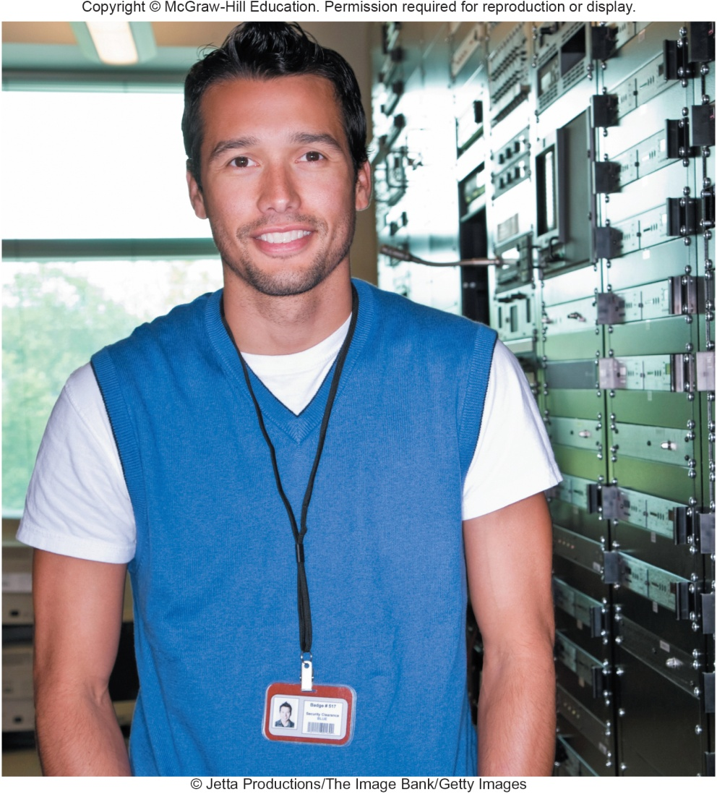
Introduction
We live in a truly connected society.
Increased connectivity potentially means increased productivity, especially in business.
You will learn more about the concept of connectivity and the impact of the wireless revolution in this chapter.

Slide 6
Communications
Computer communications is the process of sharing data, programs, and information between two or more computers
Numerous applications depend on communication systems, including
E-mail
Texting
Video Conferencing
Electronic commerce
Notes:
Applications that depend on communication systems
E-mail (key term) – sending and receiving electronic documents
Texting (key term) – short electronic messages
Video conferencing (key term) – low cost alternative to long distance
Electronic commerce (key term) – buying and selling goods electronically

Slide 7

Connectivity
Connectivity uses computer networks to link people and resources
Connects your personal computer to other computers and resources on a network and the Internet
The Wireless Revolution
Single most dramatic change in connectivity in the past decade
Allows connectivity with anyone from almost anywhere at any time
The Revolution is just beginning
Notes:
Connectivity (key term) means you can connect your PC to other PCs and information sources almost anywhere.
Wireless revolution
Use of mobile or wireless devices like smartphones and tablet PCs
The revolution is the support of more than just the wireless telephone. Today’s mobile devices support e-mail, web access and other internet applications
Many devices can and will connect to one another without any physical connection

Slide 8
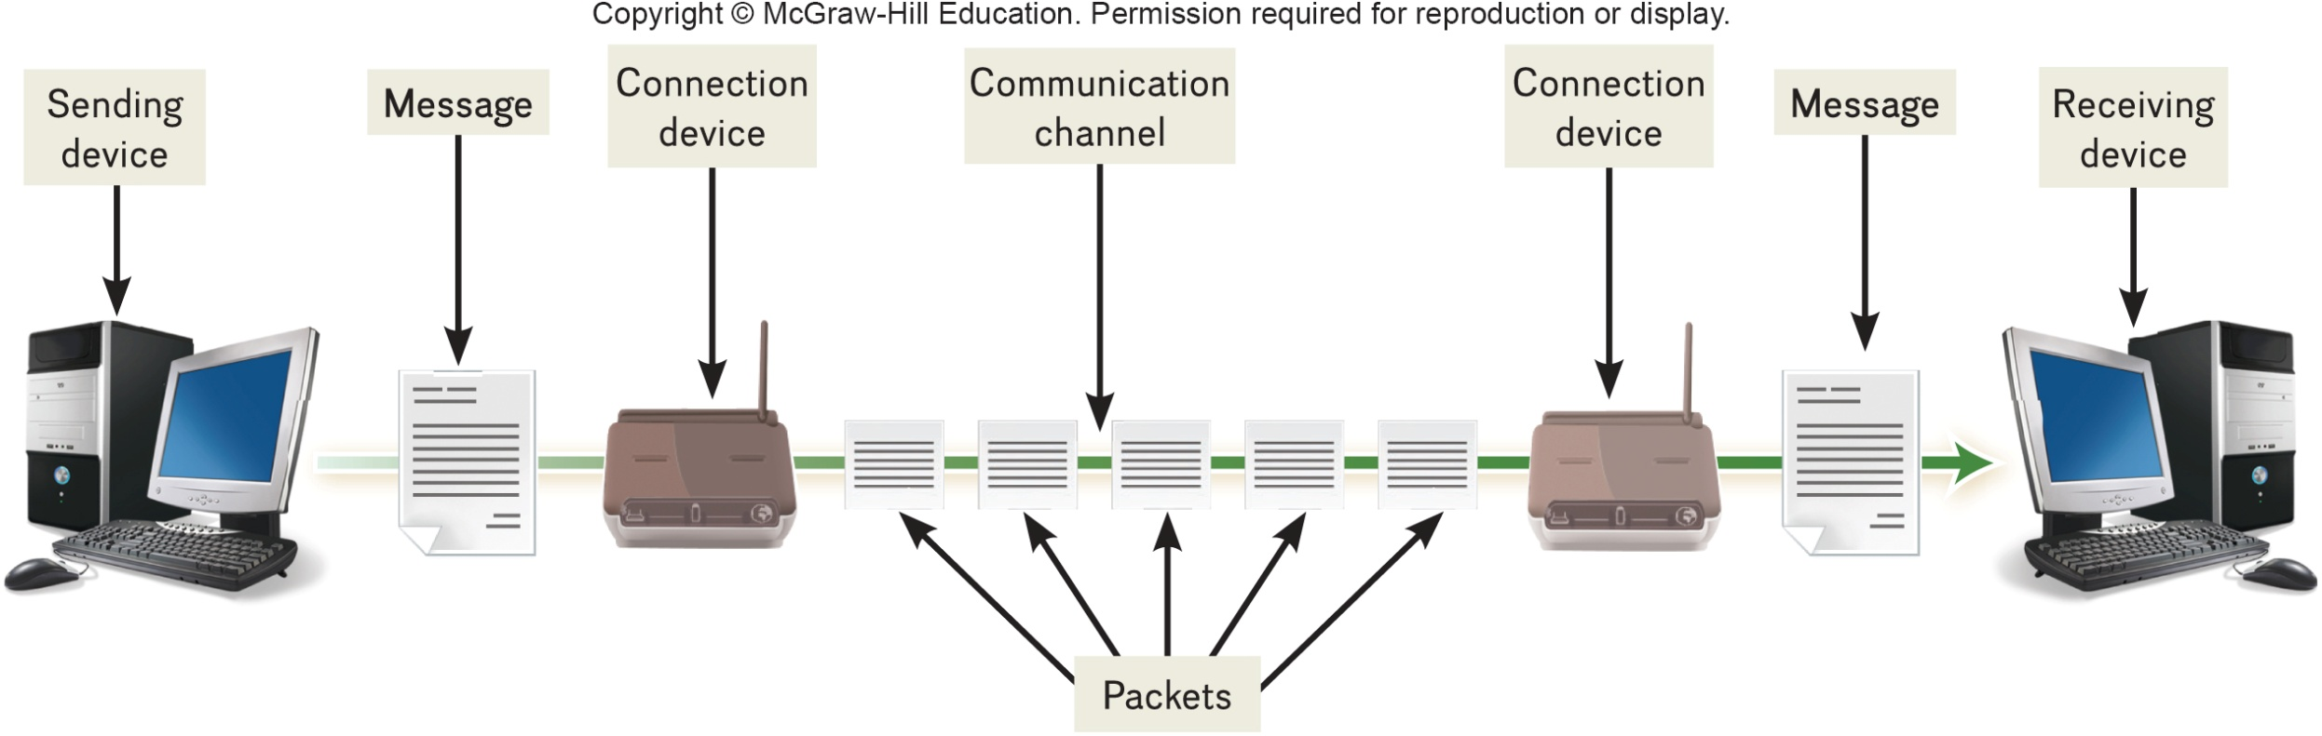
Communication Systems
Electronic systems that transmit data from one location to another
Notes:
Communication systems (key term) are electronic systems that transmit data from one location to another
Communication systems can be wired or wireless

Slide 9
Basic Elements of Communication
Four basic elements of communication systems
Sending and receiving devices
Computer or a specialized communication device
Connection devices
Interface between sending and receiving device
Data transmission specifications
Rules and procedures that coordinate the devices
Communication channel
Carries the message
Notes:
Basic elements
Sending and receiving devices (key term) – computer or a specialized communication device
Connection devices (key term) – act as an interface between sending and receiving devices; convert outgoing messages into packets (key term) that can travel across the communication channel
Data transmission specifications (key term) – rules and procedures that coordinate the sending and receiving devices
Communication channel (key term) – carries the message. Can be physical wire or wireless

Slide 10
Communication Channels
Communication channels carry the data from one computer to another; essential element of every communication system
Two categories of communication channels
Physical Connections using wire or cable
Wireless Connections
Notes:
Two categories of communication channels: physical and wireless

Slide 11
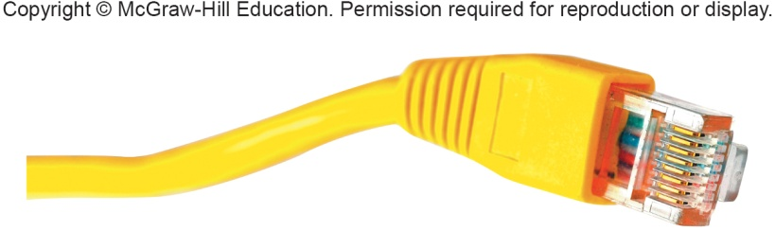
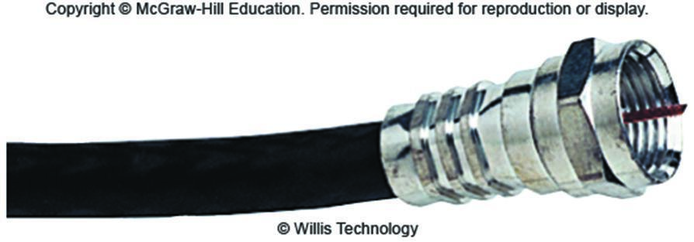
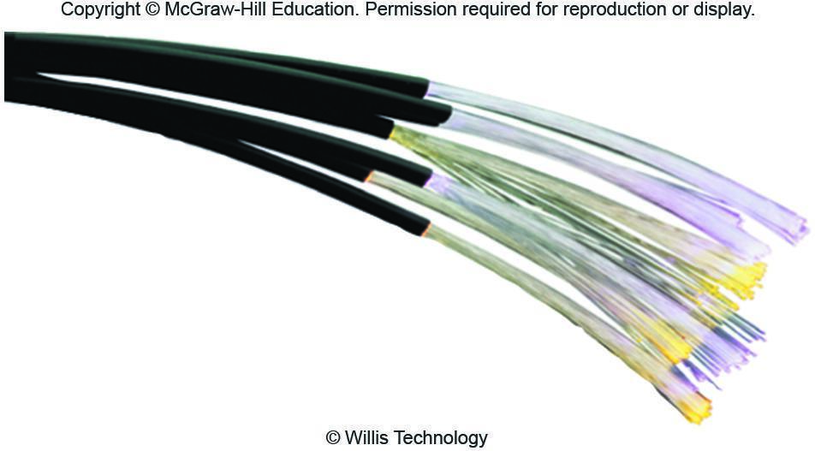
Physical Connections
Physical connection between sending and receiving device include
Twisted pair cable: two pairs of copper wire twisted together
Telephone lines
Ethernet cables
Coaxial cable: single solid copper core
Cable TV
Fiber-optic cable: tiny glass tubes
Faster and more reliable than coax
Rapidly twisted pair
Notes:
Twisted-pair cable (key term) pairs of copper wire twisted together. Both telephone lines (key term) and Ethernet (key term) are twisted pair.
Ethernet cable (key term) – consists of twisted pair cable; slowest; being phased out by more advanced and reliable media
Coaxial cable (key term) – single solid copper core; 80 times transmission of twisted pair; television and computer networks
Fiber optic (key term) –transmits as pulses of light through tiny tubes of glass. More secure and reliable; best over limited distances; lighter, more reliable, and faster than coaxial cable

Slide 12
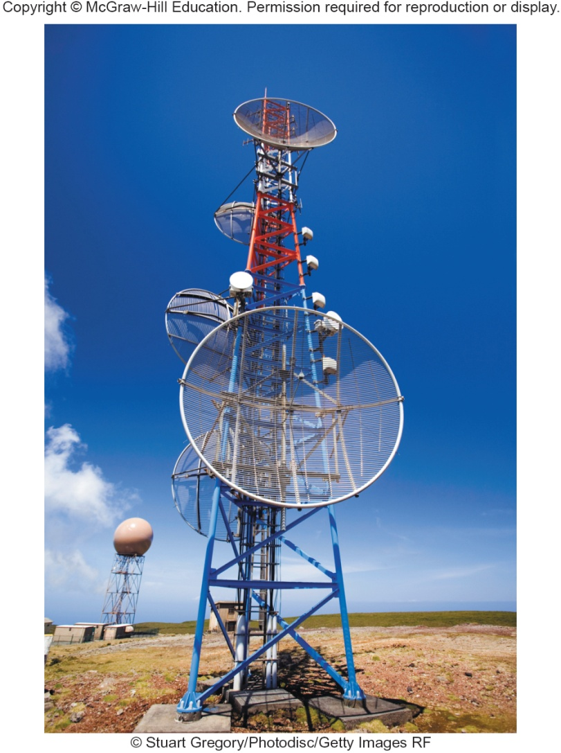
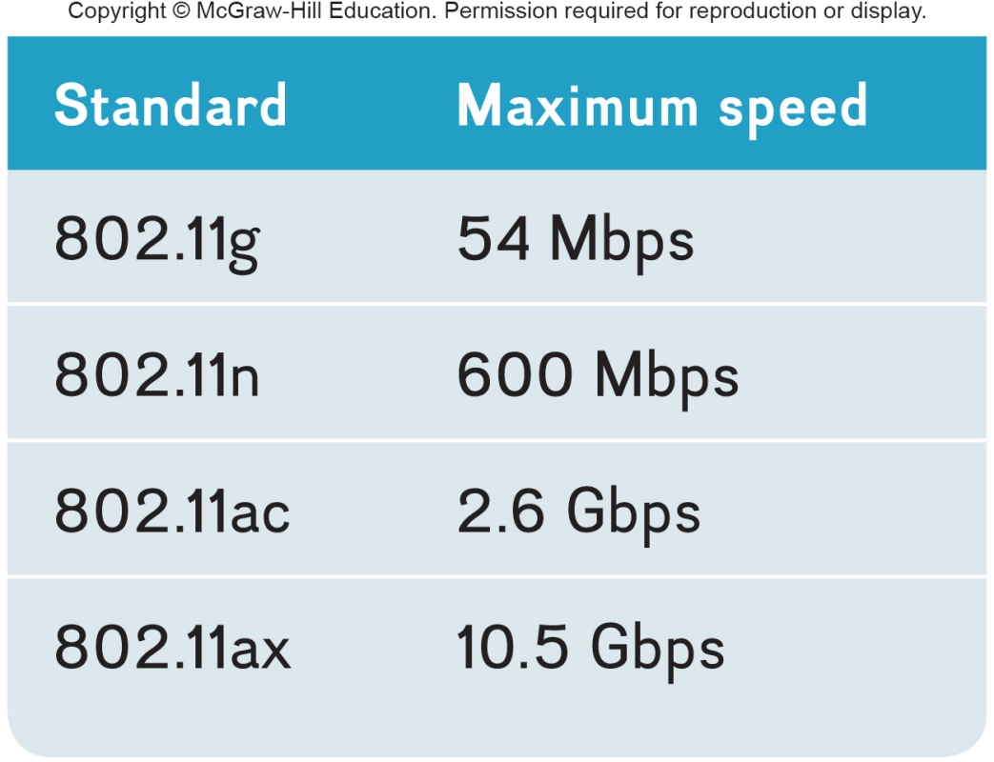
Wireless Connections
Wireless connections do not use a solid substance to connect; uses the air itself. Most use radio waves to communicate
Notes:
Wireless connections do not use a solid substance to connect; uses the air itself. Most use radio waves to communicate

Slide 13
Primary Wireless Technology
Bluetooth (short-range)
Radio communication standard
Wi-Fi (wireless fidelity)
Uses high frequency radio
Microwave
Uses high frequency radio wave signals
WiMax (extends Wi-Fi)
New standard that uses microwave to extend WiFi range
Cellular
Use multiple antennae to communication
Satellite
Uses satellites as microwave relay stations
Infrared
Use infrared light wants to communication over short distances
GPS
Determine geographic location of the devices
Notes:
Types of wireless connections are:
Bluetooth (key term) – short range radio communication standard, 33 ft, wireless headsets, printer connections, hand held devices
WiFi (key term) – wireless Fidelity communicates over short distances. WiFi standards and speeds are shown in the table.
Microwave (key term) - Uses high-frequency radio waves
WiMax (key term) – Worldwide Interoperability for microwave Access – allows greater distances for Wi-Fi.
Cellular (ley term) uses multiple antennae to communicate
Satellite (key term) uses satellites orbiting about 22,000 miles above the earth as microwave relay stations; many of these offered by Intelsat, the International Telecommunications Satellite Consortium which is owned by 114 governments and forms a worldwide communications system
Uplink (key term) sending data to a satellite
Downlink (key term) receiving data from a satellite
GPS (Global Positioning system) (key term) use a network of 24 satellites owned and managed by the Defense Department which continuously sends location information to earth
Infrared (key term)
Light waves used over short distances
Sometimes called line of sight communications
Sending and receiving devices must be in clear view of one another

Slide 14
Connection Devices
Devices need to convert digital signal to analog
Modem – modulator-demodulator
Modulation is the process of converting from digital to analog
Demodulation is the process of converting from analog to digital
Transfer rate
Speed in which modems transfer data
Usually measured in megabits per second (Mbps)
Notes:
Modem (key term) short for modulator-demodulator
Modulation (key term) – convert from digital to analog
Demodulation (key term) - convert from analog to digital
Transfer rate (key term) – rate in Mbps data transmits

Slide 15
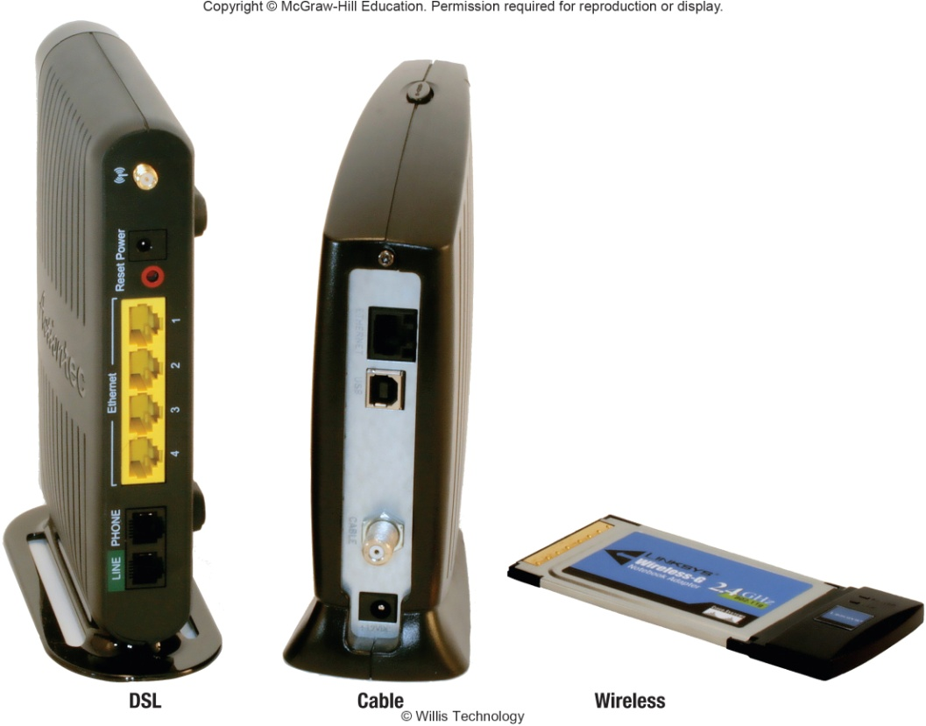
Types of Modems
Types of Modems
Digital subscriber line (DSL)
High speed telephone lines
Cable
Uses coaxial cable
Wireless
Also known as WWAN
Notes:
Types of modems
Telephone (key term)
DSL (digital subscriber line) (key term) – uses standard phone lines to create a high speed connect. ASDL (asymmetric digital subscriber line) (key term) is one of the most widely used types of DSL
Cable (key term) - uses same coaxial cable as television
Wireless (key term) – also known as WWAN modem

Slide 16
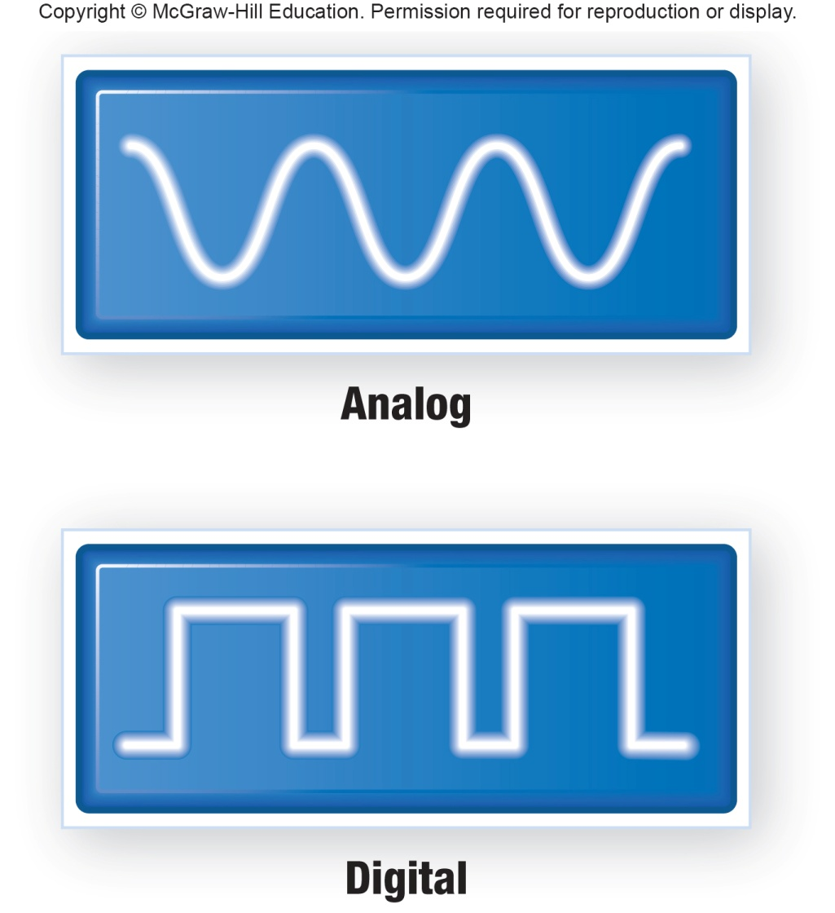
Connection Device Signals
Types of signals
Analog
Digital
Transfer rates
Mbps – million bits per second
Gbps – billion bits per second
Tbps – trillion bits per second
Notes:
Types of Signals
Sent analog (key term) – telephone signals; continuous electronic wave
Sent digital (key term) – computer signals; presence or absence of an electronic pulse; on/off
Transfer Rate (key term) – the speed in which modems transmit data

Slide 17
Connection Services - Corporations
Leased lines
T1 combined to form T3 and DS3
Have been replaced by OC lines
Faster optical carrier lines
Higher capacity
Not affordable for individuals
Notes:
T1, T2, and T3 leased lines – do not require conventional modems and provide very high capacity and is expensive.
Being replaced by optical carrier (OC) lines

Slide 18
Connection Services - Individuals
Digital subscriber line (DSL)
Uses phone lines
ADSL is most widely used type of DSL
Cable
Uses existing TV cable
Faster than DSL
Satellite connection services
Use almost anywhere
Slower than DSL and cable modem
Cellular Services
3G, 4G and 5G cellular network connectivity
Fiber Optic Service (FiOS)
New technology
Google and Verizon
Notes:
Dial up was the original service using existing telephones and telephone modems to connect to the Internet. This type of service has been replaced by higher-speed connection services including DSL, cable, satellite, and cellular services.
DSL (key term) – uses existing telephone lines to provide high-speed connections; uses DSL modems, ADSL – asymmetric digital subscriber line. Replaced dial-up services (key term)
Cable (key term) – Cable connections reach 90% of homes in America
Satellite/air connection services (key term) – two-way satellites capable of handling both uploading and downloading; available almost anywhere but slower than DSL
Cellular services (key term) – option for mobile devices and laptops using 3G and 4G cellular networks (key term)
1G (key term) started in the 1980s using analog radio signals
2G (key term) started in the 1990s using digital radio signals
3G (key term) started in the 2000s with the marketing of smartphones
4G can use WiMax and LTE to provide faster transmissioins. 10 times faster than 3G
5G is the most recent generation, with speeds that rival home Internet connections.

Slide 19
Data Transmission
Factors that affect data transmission
Bandwidth is how much information can move across the communication channel in a given amount of time
Measurement of the width or capacity of the communication channel
Categories of bandwidth
Voiceband (or low bandwidth) – standard telephone
Medium band – leased lines for high-speed
Mid-range computer and mainframes
Broadband for DSL, cable, satellite connections to the Internet
Baseband for individual connections for computers in close range
Notes:
Several technical matters affect how data is transmitted. These factors include bandwidth and protocols.
Bandwidth ((key term) – measurement of the width or capacity of the communication channel. It means how much information can move across the communication channel in a given amount of time.
Four Types
Voiceband (key term) – also known as low bandwidth (key term); standard phone line; too slow for many types of transmissions – especially high-quality video; typical speeds are 56 to 96 kbps
Medium band (key term) – with special leased lines to connect minicomputers and mainframes as well as to transmit data over long distances (for larger computer systems); not typically used by individuals
Broadband (key term) – used for high-capacity transmissions (DSL, cable, satellite connections); specialized high-speed devices; effectively transmits high-quality video and other communication needs; typically 1.5 mbps; higher speeds possible
Baseband (key term) – widely used to connect individual computers that are located close to one another

Slide 20
Making IT Work for You ~ Mobile Office
Have an “always-on” connection to access e-mail, websites, cloud services, and apps.
Devices that can keep you always connected
Mobile Hotspot Device
Personal Hotspot
Public Wi-Fi
Devices that can keep you always like home
Cloud Storage
Video conferencing

Slide 21
Protocols
Communication rules for exchanging data between computers
HTTPS – Hypertext Transfer Protocol Secure
Widely used to protect the transfer of sensitive data
Notes:
Protocols (key term) Rules for exchanging data between computers
HTTPS (key term) – hypertext transfer protocol secure is becoming widely used to protect the transfer of sensitive information

Slide 22
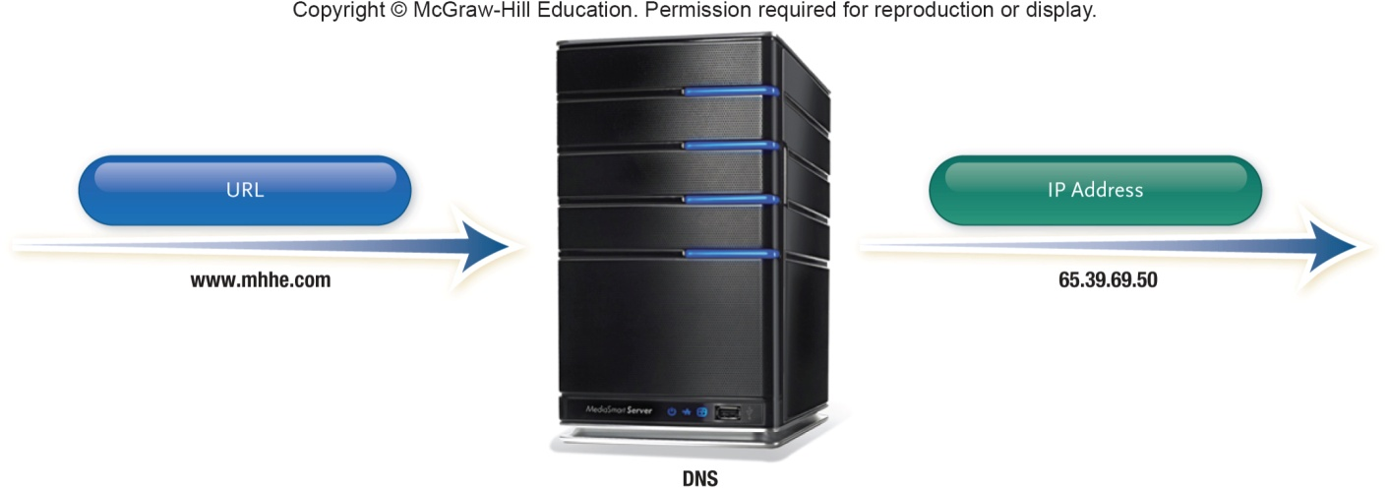
TCP/IP
TCP/IP (Transmission control protocol/Internet protocol)
Most widely used protocol
Each computer is identified with unique IP (Internet Protocol) address
DNS – Domain name service resolves IP addresses to names
Packetization – information broken down into small parts (packets) and then reassembled
Notes:
TCP/IP (key term) - Internet Standard
Essential features of protocol
Identification - Identifying sending and receiving devices. Every computer on the Internet has a unique numeric address called an IP Address, Internet Protocol address (key term)
Domain Name Server (DNS) (key term) converts text-based addresses to IP addresses
Packetization – allows message to be broken into small parts called packets (key term) so easier to transmit over Internet through various interconnected networks; allows message to be reassembled at destination

Slide 23
Part 2: Network

Slide 24
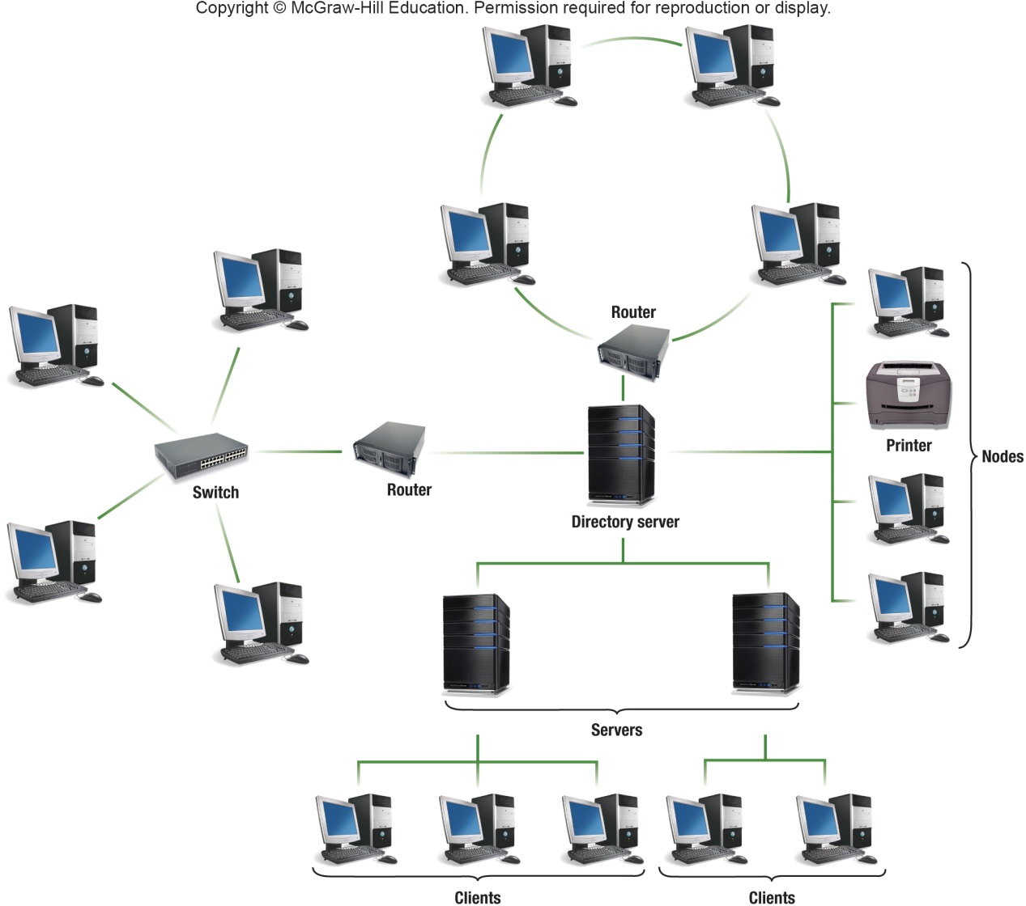
Networks
A communication system that connects two or more computers so they can exchange information and share resources
Notes:
A computer network (key term) is a communication system that connects two or more computers so that they can exchange information and share resources
Instructor – identify these terms using the graphic –
Nodes (key term) any device connected to a network
Client (key term) a node that requests and uses resources from other nodes
Server (key term) a node that share resources with other nodes
Directory server (key term) – specialized server that manages resources
Host (key term) computer system that can be accessed over a network
Router (key term) node that forwards or routes data packets
Switch (key term) central node that coordinates the flow of data. These tasks used to be performed by a hub (key term)
Network interface cards (NIC) (key term) expansion card that connects a computer to a network
Network operating system (NOS) (key term) control activities of all computers on the network
Network administrator (key term) computer specialists responsible for network operations

Slide 25
Specialized Terms in a Network
Nodes
Any device connected to a network
Client
A node that requests and uses resources from other nodes
Server
A node that shares resources with other nodes
Directory Server
Specialized server that managers resources
Host
Computer system that can be accessed over a network
Router
Node that forwards or routes data packets
Switch
Central node that coordinates the flow of data
Network Interface Cards (NIC)
Expansion card that connects a computer to a network
Network Operating System
Control activities of all computers on the network
Network Administrator
Computer specialists responsible for network operations
Notes:
Instructor – identify these terms using the graphic –
Nodes (key term) any device connected to a network
Client (key term) a node that requests and uses resources from other nodes
Server (key term) a node that share resources with other nodes
Directory server (key term) – specialized server that manages resources
Host (key term) computer system that can be accessed over a network
Router (key term) node that forwards or routes data packets
Switch (key term) central node that coordinates the flow of data. These tasks used to be performed by a hub (key term)
Network interface cards (NIC) (key term) expansion card that connects a computer to a network
Network operating system (NOS) (key term) control activities of all computers on the network
Network administrator (key term) computer specialists responsible for network operations

Slide 26
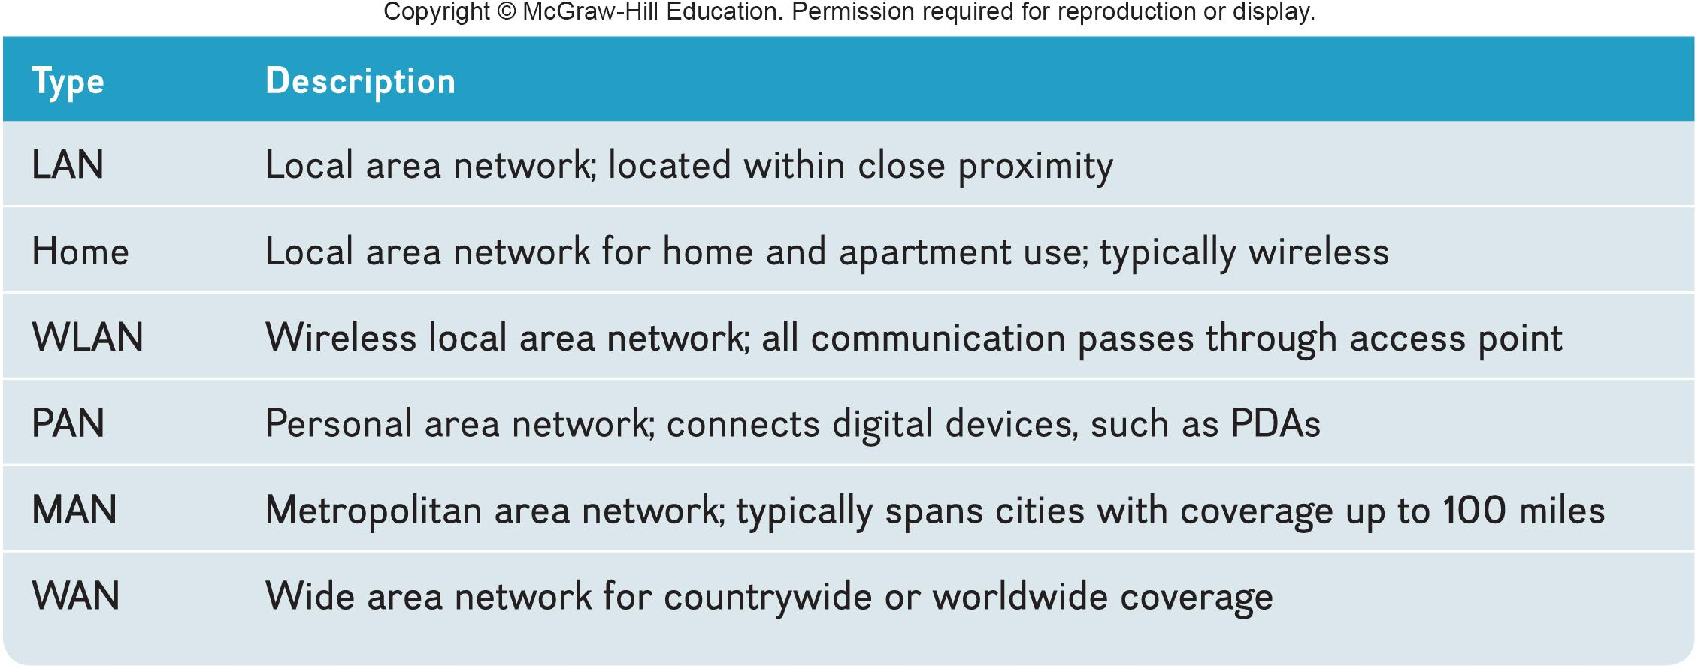
Network Types
Notes:
Communications networks differ in geographical size. Three important types are:
Local area networks - LANs (key term) Computers and devices linked in distances of less than a mile
Linked by cable. Benefits are for economy and flexibility. With network gateways (key term) , LANs can be connected to other LANs or any other type of network. Ethernet (key term) is one standard for connecting network nodes together.
Home Networks (key term) – LANs are now being commonly used by individuals in home/apartments; allow different computers to share resources including a common Internet connection; can be connected by various means including a wireless LAN (WLAN)
Wireless LAN (key term) – wireless local area network
All communications pass through the network’s centrally located wireless access point (key term) or base station (key term)
Hotspot (key term) is a wireless access point that is open to the public
Personal Area networks (key term) – works within a very small area
Connects cell phones to headsets, PDAs to other PDAs, keyboards to cell phones, etc.
MANs (metropolitan area network) (key term) –span distances up to 100 miles
Network linking nodes and resources within the geographical bounds of a city
WANs (wide area networks) (key term) - Countrywide and worldwide networks
Use microwave relays and satellites to reach users
Internet is the widest WAN

Slide 27
Network Architecture
How the network is arranged and resources are shared
Network Topology
Physical arrangement of the network
Network Strategy
How the information and resources are shared
Notes:
Network topology (key term) is the physical layout.
Bus network (key term) is where each device is connected to a common cable called a bus (key term) or a backbone(key term)
Ring Network (key term) all communications travel along a ring
The most commonly used today are the star, tree and mesh.
Network Architecture (key term) describes how a network is arranged and how resources are coordinated and shared

Slide 28
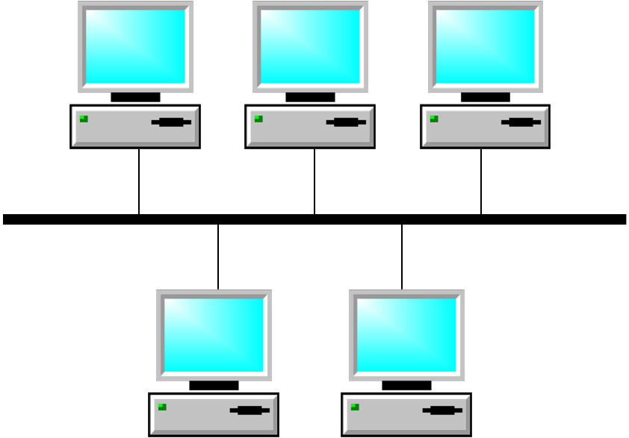
Bus Network
Topology where each device connected to a common cable called a bus or backbone
Notes:
Bus network (Key Term) – each device is connected to a common cable called a bus or backbone, and all communications travel along this bus

Slide 29
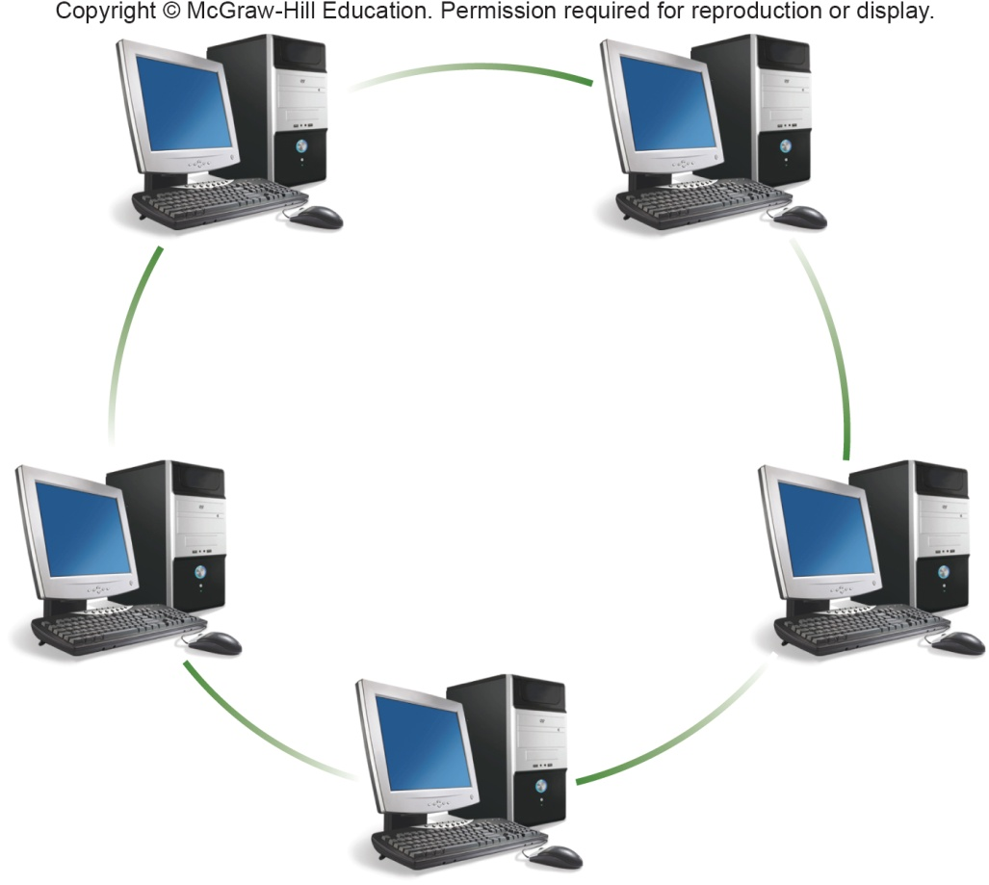
Ring Network
Topology where each device connected directly to every others network switch
Notes:
Ring network (Key Term) –Each device is connected to two other devices forming a ring
When a message is sent it passes through each device until it reaches its destination

Slide 30
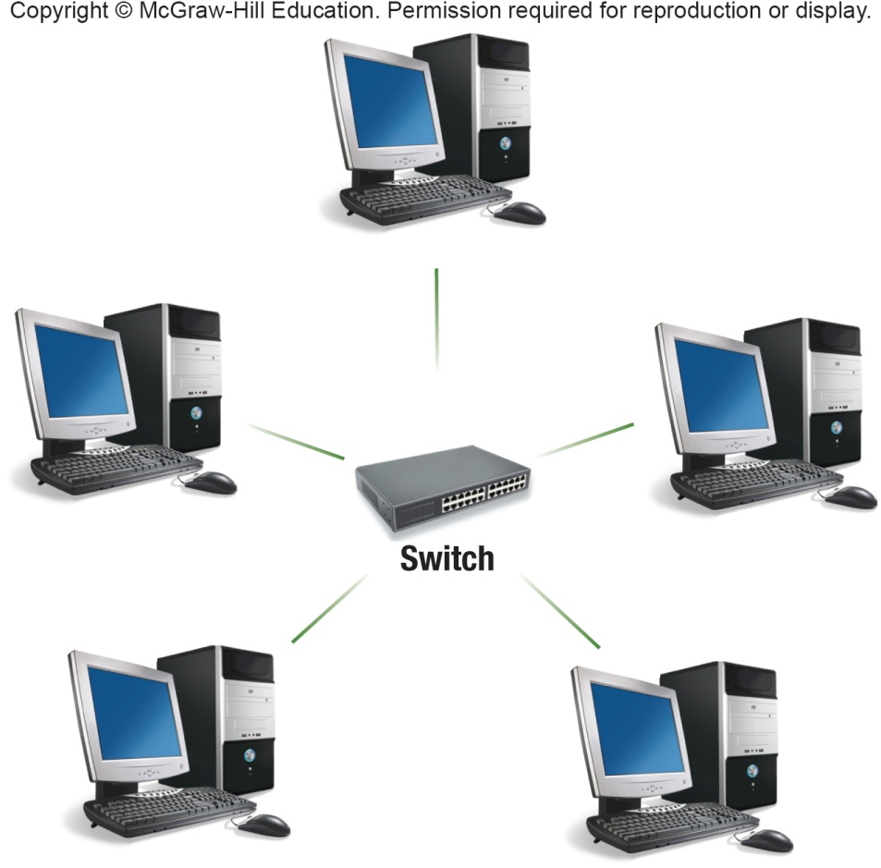
Star Network
Topology where each device connected directly to a central network switch
Notes:
Star network (Key Term) –All communications pass through the switch; each connecting device is asked (“polled”) whether it has a message to send and then each device is in turn allowed to send its message
The switch sends the message to the intended recipient.
Most widely used network topography today

Slide 31
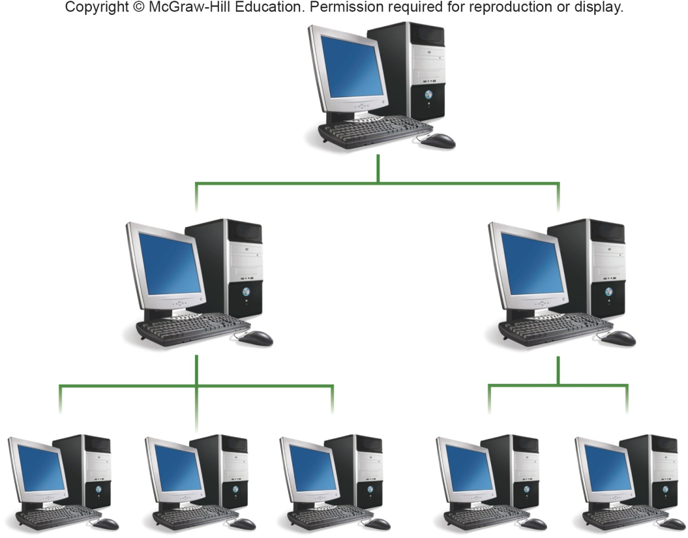
Tree Network
Topology where each device connected to a central node either directly or through subordinate nodes
Also called hierarchical
Notes:
Tree Network (key term)
Sometime called a hierarchical network (key term)
The central node is connected to two or more subordinate nodes that in turn are connected to other subordinate nodes
Useful in centralized organization

Slide 32
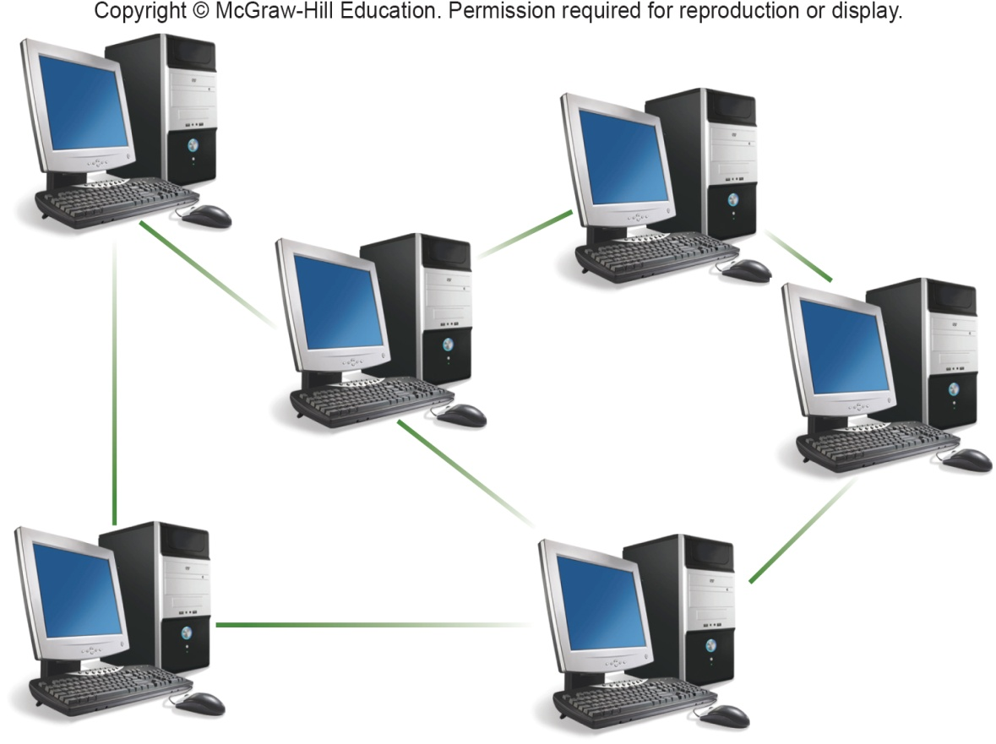
Mesh Network
Topology that does not use a specific physical layout, but requires that each node have more than one connection to other nodes
Wireless technologies are frequently used
Notes:
The mesh network (key term) is the newest type and does not use a specific physical layout. Does not use a specific physical layout, but requires that each node have more than one connection to other nodes . If a path between two nodes is disrupted, data can be rerouted around the failure using another path. Wireless technologies are frequently used to build mesh networks.

Slide 33
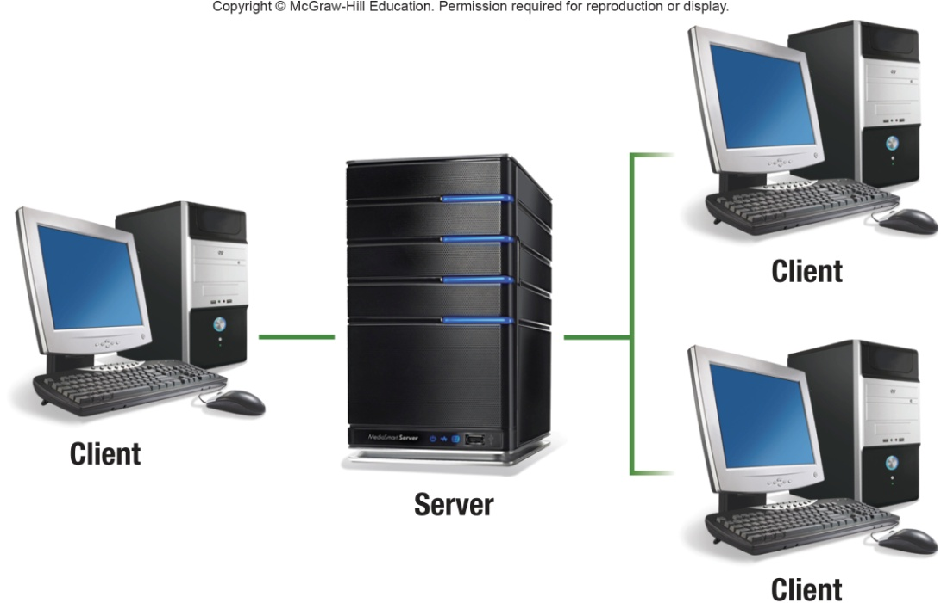
Network Strategies
Client/Server Network
Central computers coordinate and supply services to other nodes on the network
Server provides access
Peer-to-Peer (P2P) Network
All nodes have equal authority
Can act as both client and server
Notes:
Client server network (key term) widely used on the Internet
Advantages:
handle large networks efficiently
availability of powerful network management software to monitor and control network activities
Disadvantages
Cost of installation and maintenance
Commonly used server operating systems:
Windows Server
Mac OS X Server
Linux
Solaris
Peer-to-Peer (key term) all nodes are equal
BitTorrent – file sharing software
Lack of security

Slide 34
Organizational Networks
Internet technologies support effective communication within and between organizations
Intranet
Private network within an organization
Works like the Internet
Extranet
Private network that connects more than one organization
Works like the Internet, but provides suppliers and other trusted partners with limited access to the organization’s networks
Notes:
Intranet (key term) private network within an organization
Extranet (key term) private network that connects more than one organization

Slide 35
Network Security
Commonly used technologies to ensure network security
Firewall
Hardware and software that controls access to network
Proxy server provides pass-through access
Protects against external threats
Intrusion detection system (IDS)
Works with firewall to protect organization's network
Analyzes all incoming and outgoing network traffic
Virtual private network (VPN)
Creates a secure private network connection between your computer and the organization
See the graphic on the next slide demonstrating network security
Notes:
Firewalls (key term) – Organizational firewalls include a proxy server (key term) all communications between the outside world and an organization must pass through the proxy server where the source and content of each communication is evaluated.
Intrusion detection systems (NIDS) (keyword)
Uses advanced pattern matching and heuristics
Can recognize signs of a network attack and disable access before an intruder can do damage
Virtual private network (VPN)
Creates a secure private connection between a remote user and an organizations’ internal network
Creates the equivalent of a dedicated line between a user’s home or laptop computer and a company server

Slide 36
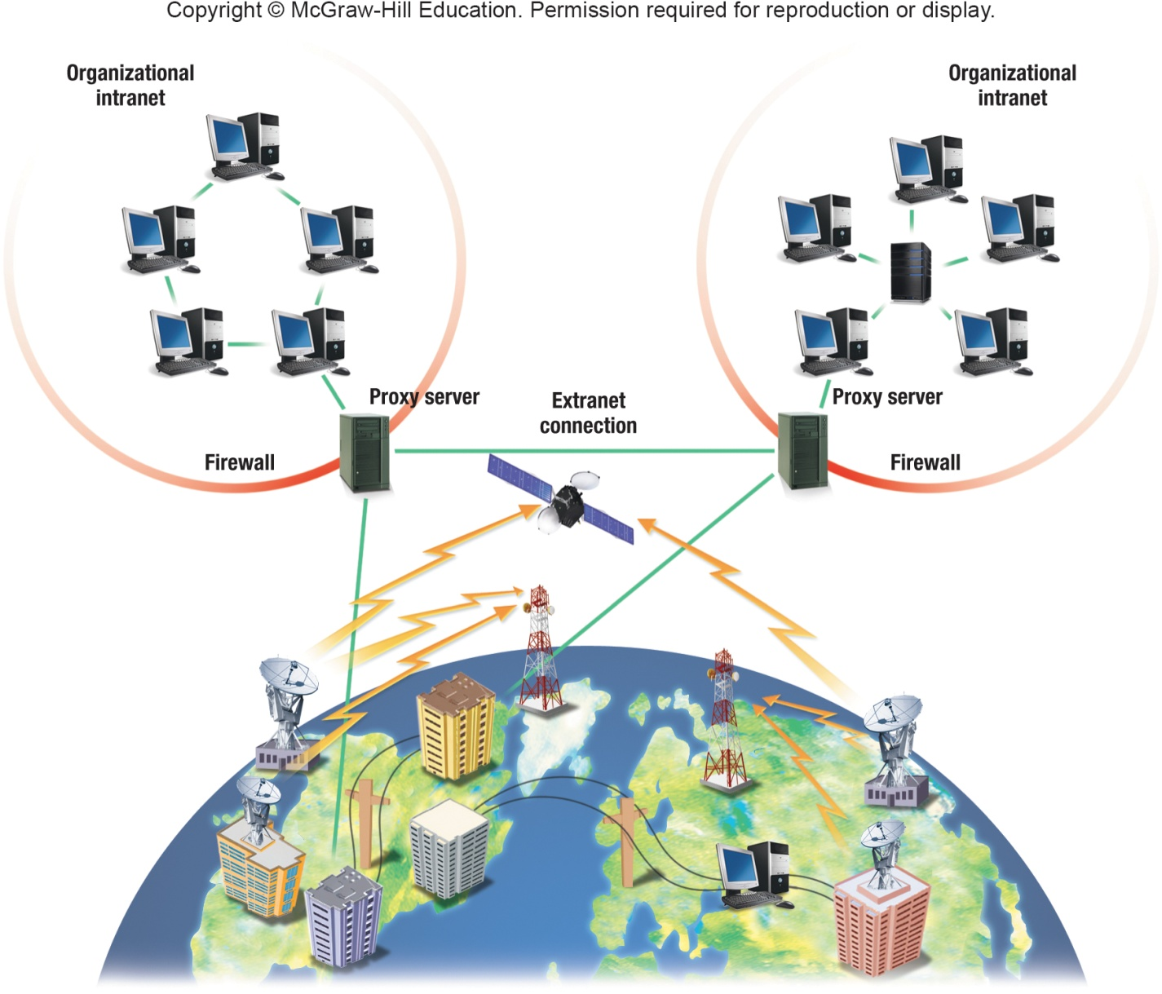
Intranet, Extranet, Firewall, Proxy Server

Slide 37
Part 3: Careers in Network

Slide 38

Careers In Network
Network Administrator
Manages a company’s LAN and WAN networks
Maintains networking hardware and software, diagnosing and repairing problems that arise
Candidates usually have a bachelor’s or associate’s degree in computer science, computer technology or information systems
Practical networking experience
Annual salary is typically between $47,000 and $64,000

Slide 39
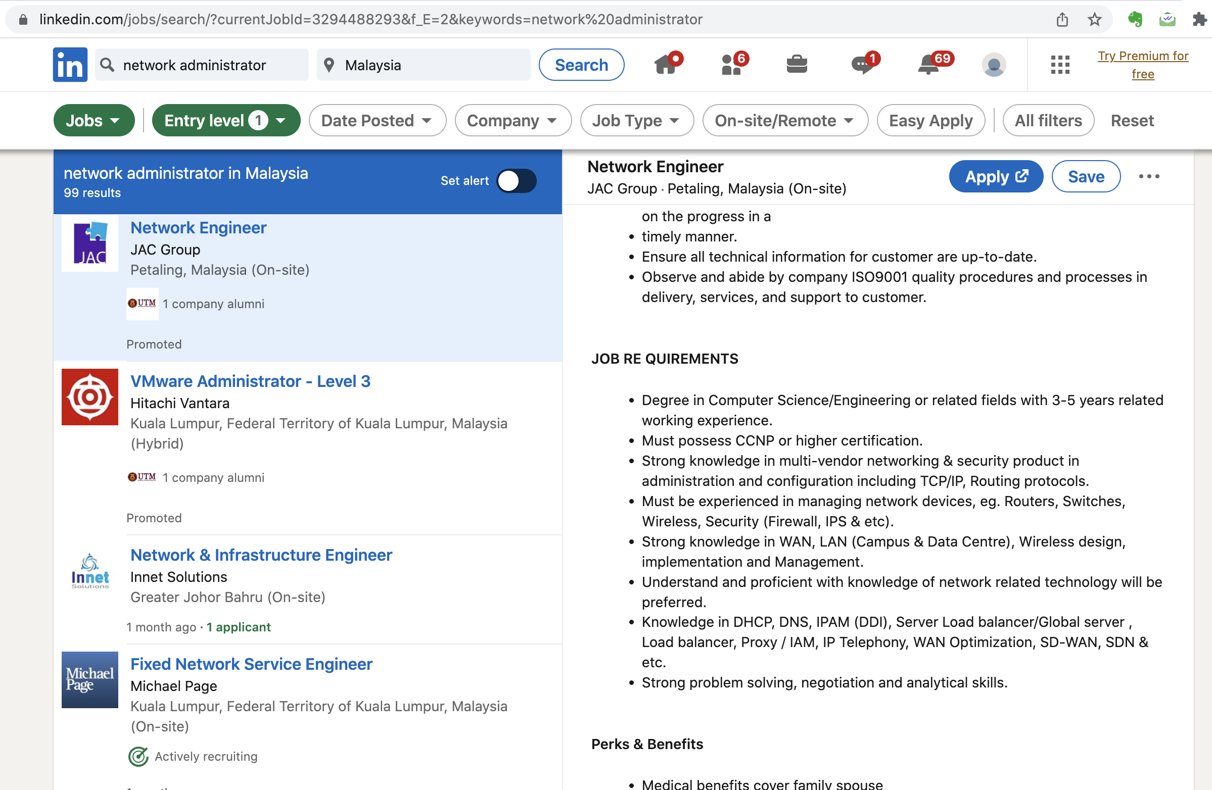
Careers In Network (LinkedIn)

Slide 40
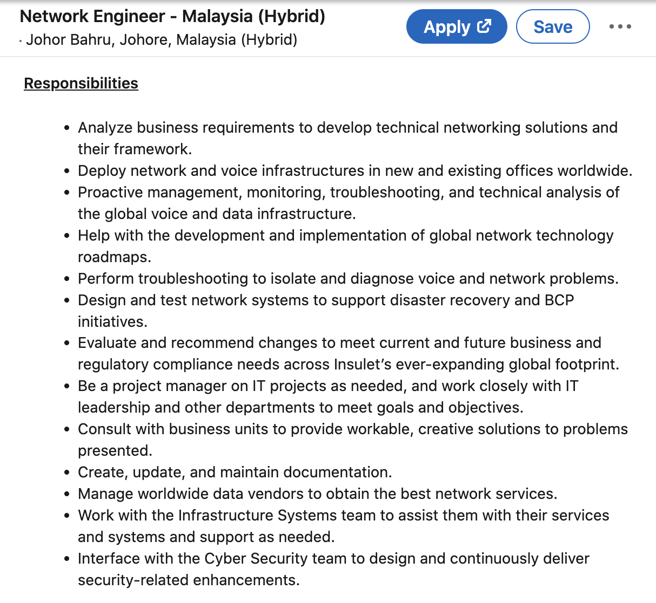
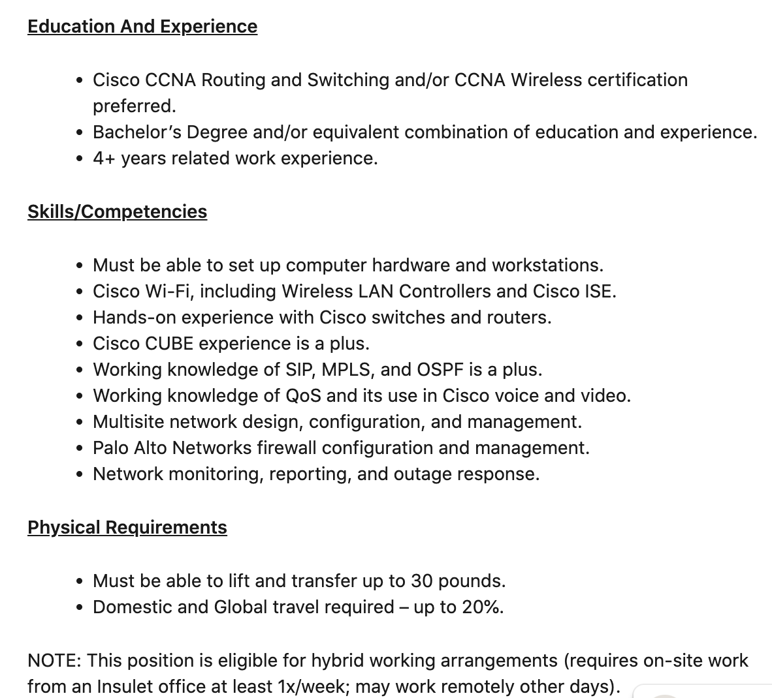
Careers In Network (LinkedIn)

Slide 41
Part 4: Trends in Network

Slide 42








Trends in Network Technologies
AI & ML
5G & WI-FI 6
AR & VR
IOT
DIGITAL TRANSFORMATION
CLOUD COMPUTING
DATA SECURITY
DEVOPS

Slide 43
5G and Wi Fi 6 Technology
5G or fifth generation cellular technology.
Characteristics:
increased speed, reduced latency and improve flexibility in wireless services.
Helps organizations to mobilize workforces, extend automation, supporting new applications with increased network capacity and high data rates.
Solve the issue of many wireless devices connected at once.
Wi Fi 6
Infrastructure.
Computers and mobile phones manufacturers need to adopt new standards.

Slide 44
Artificial Intelligence (AI) and Machine Learning (ML)
Addressed complex network and business problems in real time.
ML
Make predictions based on network data.
AI
Can take intelligent actions based on those prophecies.
Advanced analytics into automation systems will bring in self-operating networks.

Slide 45
Augmented Reality and Virtual Reality
Technologies empower the applications and customer experiences.
Mainly used on smartphone and tablets.
E.g. to present interior design, allowing shopkeepers to have virtual presentation of furniture.

Slide 46
Cloud Computing
Allows faster transition to remote work.
Help to organize remote workplace more efficiently.
Contributed to business continuity during any crisis.
Maintaining consistent network and security policies across multiple clouds using multi cloud policy management.

Slide 47
DevOps
Tied up to software development and IT.
Improve relationship between network service designers and engineers to make operational changes to the services.

Slide 48
Digital Transformation
Enables adoption of digital technology to transform services or businesses.
Replacing on digital or manual processes with digital processes.
E.g. digital forms that are processed, stored, and transmitted via digital devices and networks.

Slide 49
Internet of Things (IoT)
Connecting the unconnected.
Capable to communicate and connect with other devices and people.

Slide 50
Data Security
Usability and integrity of network is crucial to security.
Effective network security manages network access effectively and stops a variety of threats entering or spreading within the network

